Slide 1

NLP Albumentation
ISM 6930 – DATA EXPLORATION, VISUALIZATION & ANALYSIS
By
Shailendra Singh & Enock Chemochek

Slide 2

Agenda
INTRODUCTION
ROADMAP
THE YELP DATASET
EXPLORATION
METHODS FOR AUGMENTATION
WHAT’S NEXT

Slide 3

INTRODUCTION
More YELP Reviews?
More quality data = better models
Boost model metrics for YELP reviews analysis
Hypothesis: By creating more observations we can create better clustering models that can distinguish between groups better.
What type of data to use?
Augmentation using a specific domain data might fail on data from different domain.
By obtaining data which comprises of diverse domains might help in solving data imbalance issue in classification related augmentation.

Slide 4

Yelp dataset contains user reviews on various businesses.
The reviews are long thus making augmentation more realistic.
The dataset is huge, hence test-train-validation split can be diversified easily.
Source: Yelp Dataset. (2019). Yelp.com. https://www.yelp.com/dataset

Slide 5

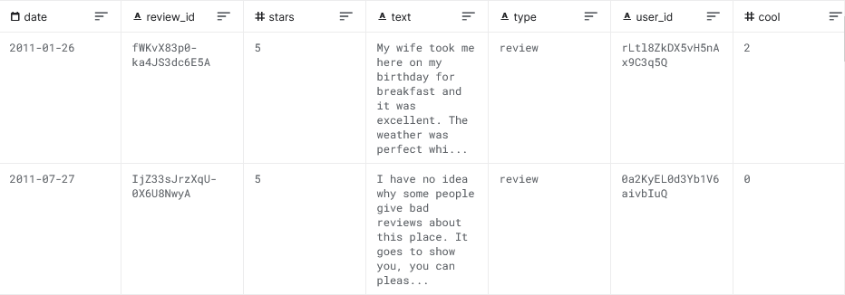
THE YELP Data
Useful Attributes: Text and Type
Use text to augment, use type for soft evaluation on target text.

Slide 6

Augmentation Techniques
Random Insertion, Deletion, and Swap [1].
Adding synthetic noise [2].
Keyword Replacement [3]
Synonyms
Hyponyms
Hypernyms
[1] (Wei and Zou, 2019) https://aclanthology.org/D19-1670/
[2] (Belinkov and Bisk, 2017) arXiv preprint arXiv:1711.02173
[3] (Toutanova et al., 2003)
https://dl.acm.org/doi/10.3115/1073445.1073478

Slide 7

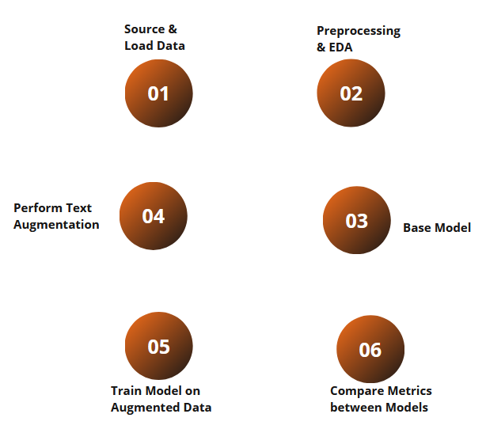
ROADMAP

Slide 8
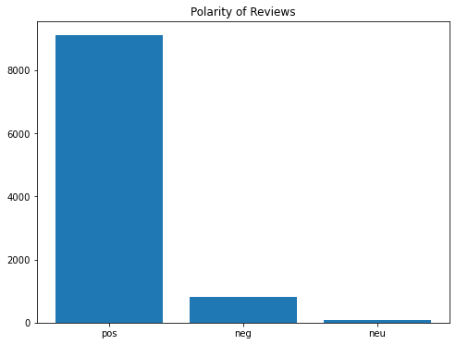
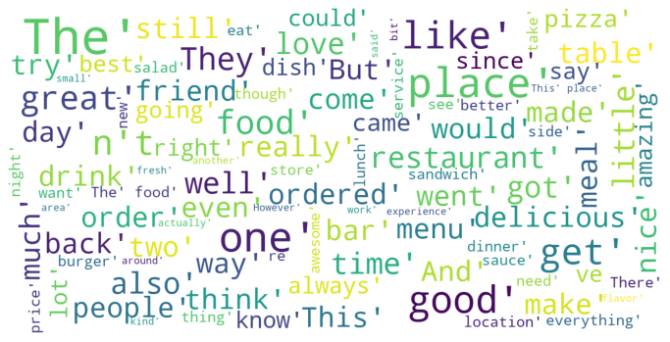
EXPLORATION
Overall sentiment
Word cloud (top 100 words)

Slide 9
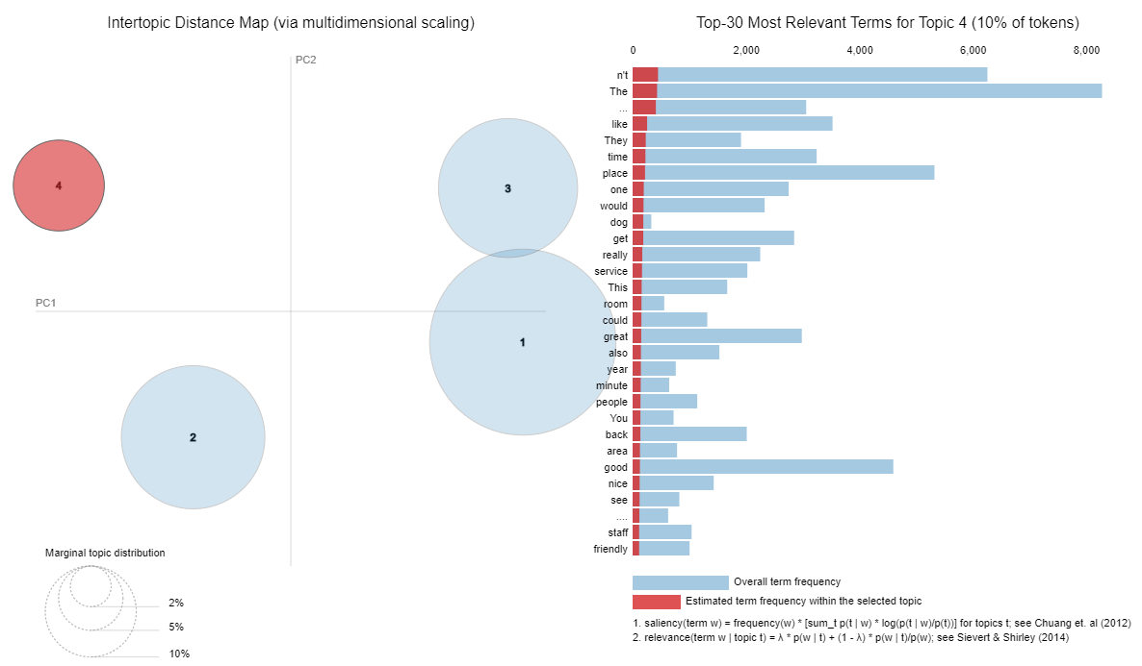
TOPICS

Slide 10
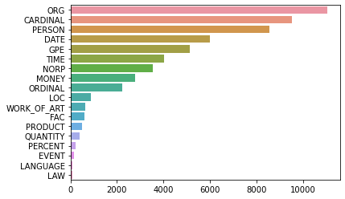
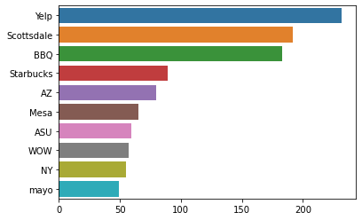
NER Distribution
Overall NER entities
Organizations

Slide 11
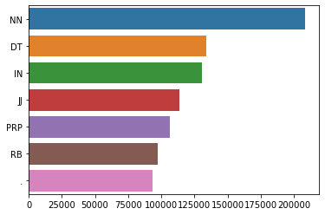
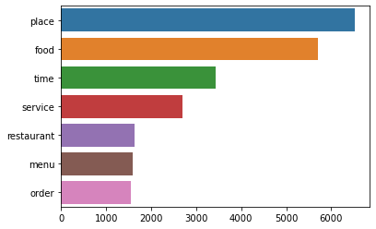
POS Distribution
POS tags overall
Nouns (NN)
NN: Noun, VB: Verb, JJ: Adjective, RB: Adverb, IN: Preposition, CC: Conjunction, PRP: Pronoun, INT: Interjection

Slide 12

What's Next
More data cleaning to limit input as non-blank, only English, and have no URLs.
Fine tune the base model
Implement code for augmentation techniques (described in previous slide)
Generate augmented reviews using context synonyms, antonyms, etc.
Evaluate (either manually for a small random sample or the full dataset).

Slide 13
THANK YOU

